Slide 1

CAPSTONE 2 INSURANCE CLAIM PATTERN IN CAR INSURANCE POLICIES
TEJAS NAKAVE
- PGA WD 47

Slide 2

Problem statement
To analyze the factors influencing insurance claim occurrences in the context of car insurance policies. The objective is to identify key features and patterns within the dataset that contribute to the likelihood of a claim being made.
By understanding these factors, insurance companies can implement targeted risk mitigation strategies, improve pricing models, and enhance customer engagement to optimize their operations and reduce claim losses.

Slide 3
Methodology
Data Collection: Gathered relevant data on insurance policies, including policy tenure, car age, policyholder age, and claim occurrences.
Exploratory Data Analysis (EDA): Explored the dataset to identify trends, correlations, and outliers among the features.
Feature Engineering: Processed and transformed features to prepare the data for modeling.
Model Selection: Evaluated various classification algorithms, with XG Boost emerging as the most promising model due to its strong performance across multiple metrics.
Model Training: Trained the XG Boost model using the dataset, optimizing parameters for accuracy, precision, recall, and F1 score.
Model Evaluation: Assessed the performance of the model on both the training and test sets to ensure its effectiveness.
Insights Generation: Derived insights from the model results to understand the impact of different factors on claim occurrences.

Slide 4
Dataset exploration
The data contains demographic details
The dataset contains 43 predictor variables and 1 predicted variable
The dataset has 58592 rows and 44 columns of data
There are no null values in the dataset.
We can convert the object type columns to categories
The following columns are dropped
Policy ID – unique identifier
Notes:
- Approx 22% space is saved by changing from object to category

Slide 5
Insights (Numerical Columns)
Policy Tenure: The average policy tenure is approximately 0.61 years, with a standard deviation of 0.41 years. The minimum tenure is around 0.0027 years, while the maximum is about 1.40 years.
Age of Car: The average age of cars insured is approximately 0.07 years, with a standard deviation of 0.056 years. The oldest car in the dataset is 1 year old, and the newest is brand new.
Age of Policyholder: The average age of policyholders is approximately 0.47 years, with a standard deviation of 0.12 years. The youngest policyholder is around 0.29 years old, and the oldest is 1 year old.
Population Density: The dataset covers areas with varying population densities, ranging from 290 to 73,430 people per area.
Make: The dataset includes cars from various manufacturers (make), with the most frequent make being represented 1.76 times on average.
Airbags: The number of airbags ranges from 1 to 6, with an average count of approximately 3.14 airbags per car.
Displacement: Engine displacement varies widely, with values ranging from 796 to 1,498 cubic centimeters (cc).
Gross Weight: The gross weight of cars in the dataset ranges from 1,051 to 1,720 kilograms.

Slide 6
Insights (Categorical Columns)
Area Cluster: The dataset includes cars from 22 different area clusters, with cluster C8 being the most frequent.
Segment: Cars are categorized into 6 segments, with segment M1 being the most frequent.
Model: There are 11 different car models in the dataset, with model M1 being the most frequent.
Fuel Type: Cars in the dataset primarily use petrol as fuel, followed by diesel and CNG.
Engine Type: Most cars have an F8D Petrol Engine.
ESC (Electronic Stability Control): Most cars in the dataset do not have ESC.
Adjustable Steering: Most cars have adjustable steering.
TPMS (Tire Pressure Monitoring System): Most cars in the dataset do not have TPMS.
Parking Sensors: Most cars in the dataset have parking sensors. Parking Camera: Most cars do not have a parking camera.

Slide 7
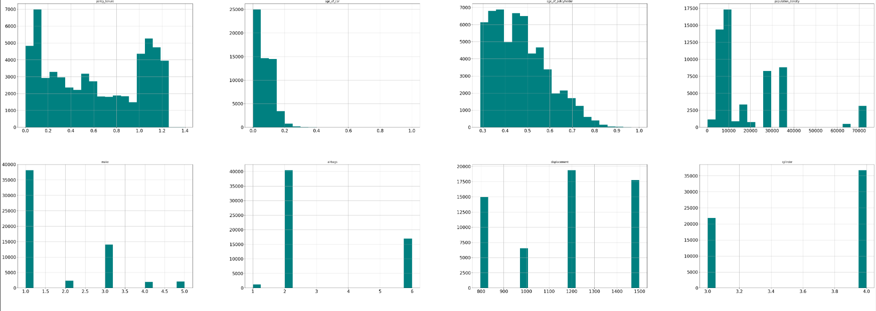
EDA

Slide 8
Insights from EDA
Most people(7000) have policy active for 0.1 years.
Majority people opt for insurance immediately when they purchase a car.
Most policy holders are 0.3-0.4 yrs of age.
Most people prefer 'make 1' car followed by 'make 3' and least preferred is '2' '4' and ‘5’.
No. of airbags in most cars is '2'(40k+) while 2nd most popular choice is '6' (17k approx.) .
'1' airbag is present in almost 1000 cars while no car has '3' ,'4' or '5' airbags.
Most cars have ncap rating of '2' (20k+) followed by rating '0' (approx. 19k).
Safer cars with rating '4' and '5' are least (<2.5k both).

Slide 9
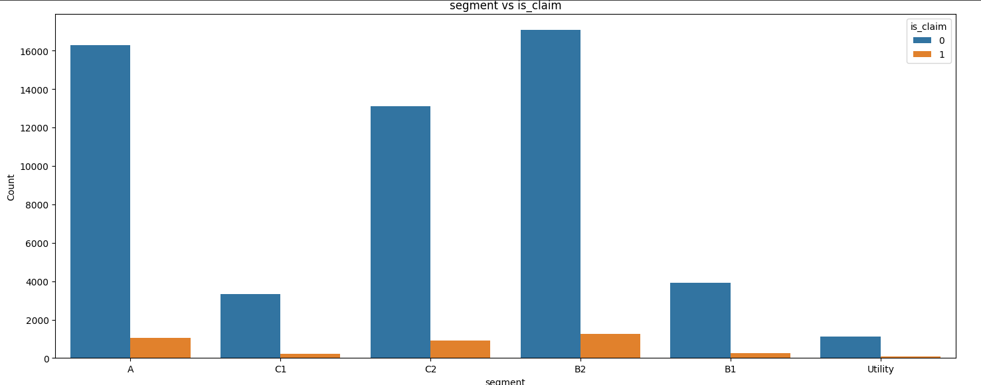
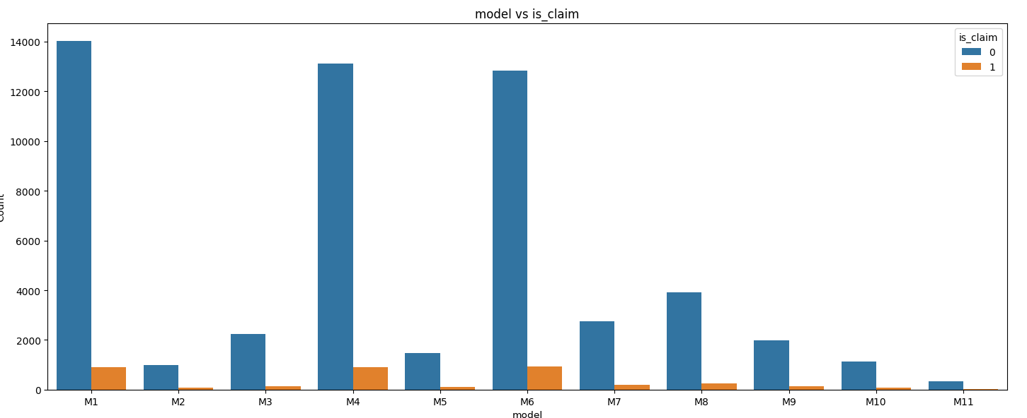
EDA ( categorical variable vs target variable )

Slide 10
Insights from EDA
Highest no. of claims(about 1000) come from area C8
Owners with models M1 M4 and M6 have highest claims (about 1000 each).
There are zero claims where speed alert system isn't present in car.

Slide 11
Data preparation for model building
It is observed that there are quite a few outliers in the data by using boxplot. But we do not treat them as they are actual data points and can prove significant in our predictions.
When classification problems exhibit a significant imbalance in the distribution of the target classes, so we have balanced the data using resampling technique, here I have SMOTE.
We define functions to provide metric scores(accuracy, recall and precision) on train and test set and a function to show confusion matrix so that we do not have use the same code repetitively while evaluating models

Slide 12
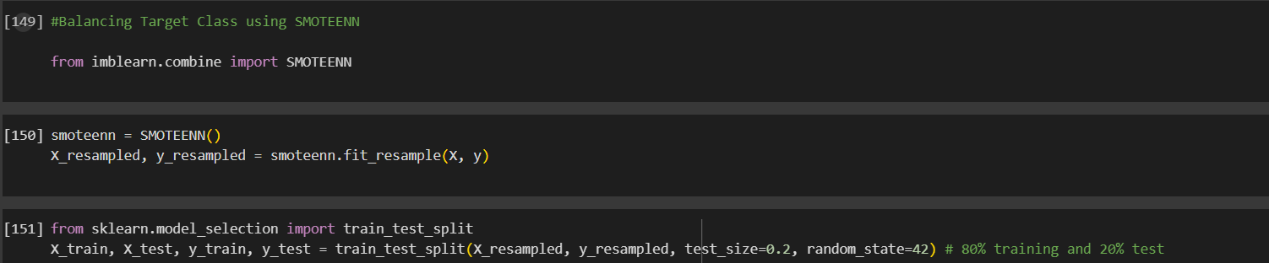
Data preparation for model building
As the data was imbalance, I have used SMOTE (Synthetic Minority Over-Sampling Technique) combined with ENN (Edited Nearest Neighbors)
SMOTEENN combines the strengths of SMOTE and ENN by first oversampling the minority class using SMOTE to increase its representation and then using ENN to clean up the dataset by removing noisy samples from both classes.

Slide 13
Model building
I have used 8 Machine Learning Algorithm:
Logistic Regression
Decision Tree
Decision Tree with Pre-pruning
Random Forest
Bagging
Ada-Boost
Gradient Boost
XG Boost

Slide 14
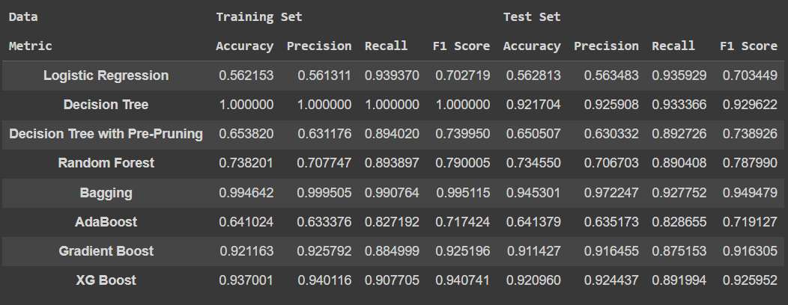
Model Building

Slide 15
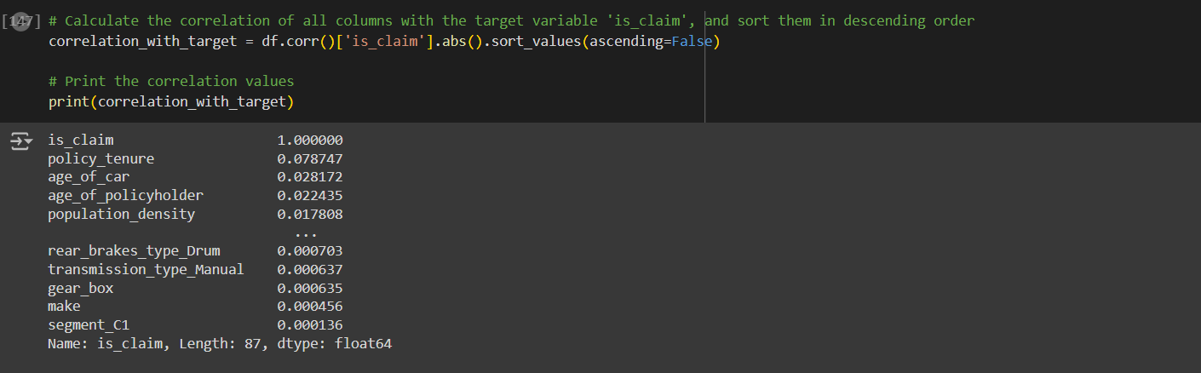
Factors Affecting Target Variable
TOP 3 factors affecting claim are :
1.Policy Tenure
2.Age of Car
3.Age of policy holder

Slide 16
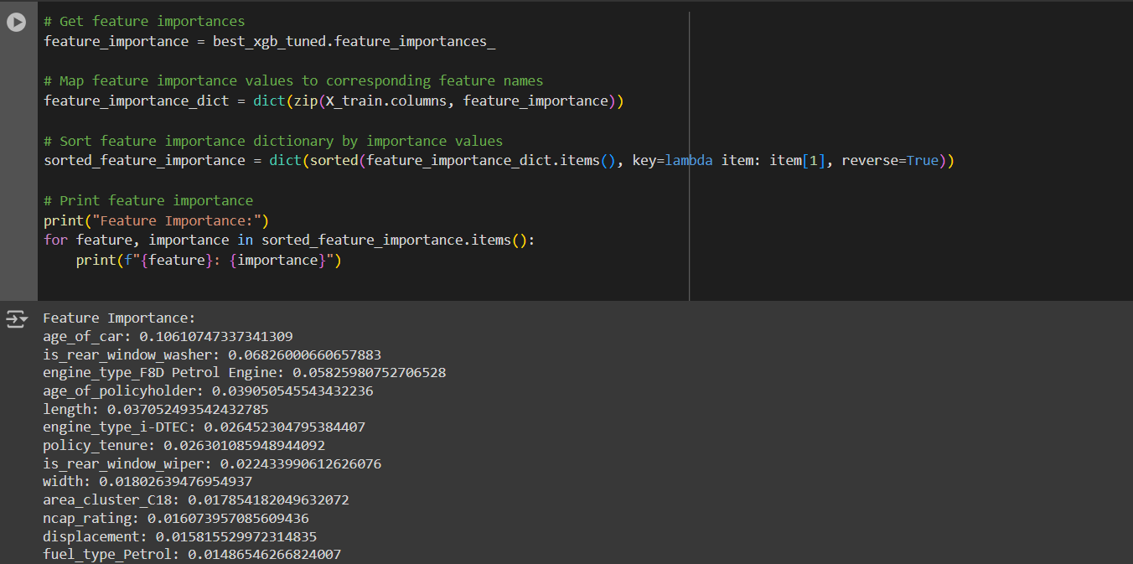
Feature Importance

Slide 17
Conclusion
Based on the evaluation of various classification algorithms, XG Boost stands out as the most promising model. It demonstrates strong performance across multiple metrics on both the training and test sets. Specifically, in terms of accuracy, precision, recall, and F1 score, XG Boost consistently achieves high scores, outperforming other classifiers.

Slide 18
Business Insights and Recommendations
The analysis highlights the following key insights for insurance companies:
Policy Tenure: Longer policy tenure may correlate with lower claim frequency, indicating higher customer loyalty and lower risk.
Age of Car: Older vehicles are more likely to have claims, suggesting the importance of adjusting premiums based on car age to reflect potential risks accurately.
Age of Policyholder: Different age groups may show unique claim patterns, requiring personalized risk management strategies and custom insurance products.

